Slide 1
Risk Management

Slide 2
The Oklahoma Department of Securities Invest Ed® program has provided this information as a service to investors. Invest Ed does not recommend any particular investment strategy or plan, any type of product, or any securities professional over another. No part of Invest Ed shall be taken as investment and/or legal advice.

Slide 3

Risk Management

Slide 4
Risk
Investing involves placing money at risk in the hopes of earning a positive rate of return.
You need to understand risk and find ways to minimize the risk in your portfolio.
Is the likelihood of loss when you invest, and if you do lose money, how much you can afford to lose.
Notes:
Risk
Investing involves placing money at risk in the hopes of earning a positive rate of return.
Risk is the likelihood of loss when you invest, and if you do lose money, how much you can afford to lose.
You need to understand risk and find ways to minimize the risk in your portfolio.

Slide 5

Portfolio
is a collection of investments assembled to meet one or more investment goals
Notes:
A portfolio is a collection of investments assembled to meet one or more investment goals.

Slide 6
“Risk means more things can happen than will happen.”
Elroy Dimson
Notes:
“Risk means more things can happen than will happen.” Elroy Dimson
Risk cannot be eliminated, you can only try to reduce and control the risk in your portfolio.

Slide 7
Risk
The lower the price you pay for a stock, the less you can lose.
Price and risk are connected.
Notes:
The following are some guidelines about risk:
Price and risk are connected. The lower the price you pay for a stock, the less you can lose. You should always try to buy a good business at the lowest price possible. In addition, the lower the price we pay for a stock, the higher the return, all else equal. For example, if a stock will be worth $20 in two years, do you make more profit if you buy it today at $10 or $12 per share?
You should think about the different possible outcomes for a business, not only what you want to happen. What would happen if there is an economic recession? What would happen if the company had a bad quarter? Is the company’s stock “priced for perfection”? If so, any bad news will certainly damage the stock.

Slide 8
Risk
Never put money that you need next month, or even next year, at risk.
Be aware of your level of risk aversion in the market.
Never put money in the stock market that, if it went to zero, would affect your lifestyle.
Notes:
Never put money in the stock market that, if it went to zero, would affect your lifestyle. Never put money that you need next month, or even next year, at risk.
Be aware of your level of risk aversion in the market.

Slide 9
Risk Aversion
When people have low risk aversion, they do not fear risky investments and they will pay higher prices for assets. An investor with low risk aversion has a high risk tolerance. When people have a high risk aversion, they are terrified of losing money and they are reluctant to own stocks.
Is a measure of a person’s attitude towards risk.
Notes:
Risk aversion is a measure of a person’s attitude towards risk. When people have low risk aversion, they do not fear risky investments, and they will pay higher prices for assets. An investor with low risk aversion has high risk tolerance. When people have a high risk aversion, they are terrified of losing money and they are reluctant to own stocks.

Slide 10
“Be fearful when others are greedy, and greedy when others are fearful.”
Risk aversion is usually higher at the end of a bear market, and risk aversion is usually low at the top of a bull market.
-Warren Buffett
Notes:
Usually when risk aversion is the highest is at the end of a bear market, and risk aversion is the lowest at the top of bull markets. The great investor Warren Buffett has said “Be fearful when others are greedy, and greedy when others are fearful”.
Bull Market- a time of rising prices in the financial markets; e.g., stock prices go up in a bull market
Bear Market - a period of falling prices in a financial market, e.g., stock prices go down during a bear market

Slide 11
Leverage-borrowed money
Increases your risk
Magnifies your rate of return
Introduces the possibility that a decline in your investments might leave you in debt to your brokerage firm
Leaves an investor more susceptible to large drops in the market
Notes:
Leverage increases your risk. Leverage, or borrowing, magnifies your rate of return, and introduces the possibility that a decline in your investments might leave you in debt to your brokerage firm. Leverage leaves the investor much more susceptible to large drops in the market.

Slide 12

Please avoid borrowing money to put at risk in the stock market!
Leverage
Notes:
Please avoid borrowing money to put at risk in the stock market.

Slide 13
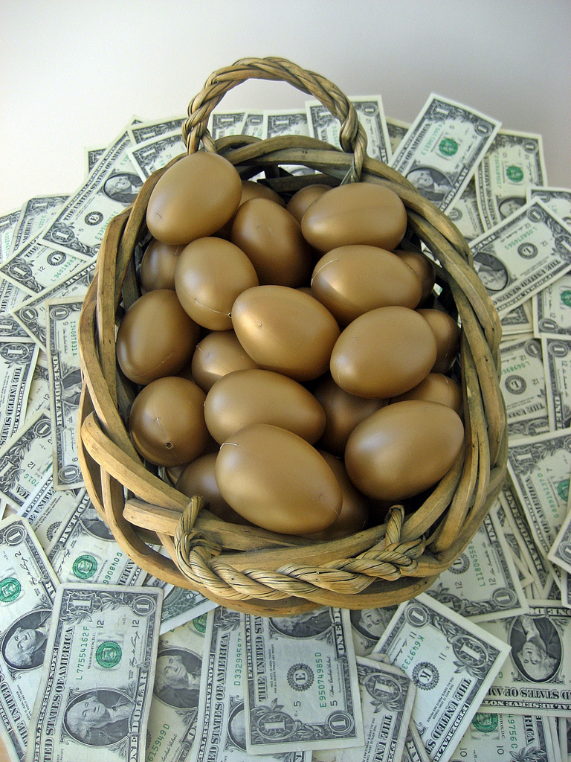
Diversification
http://401kcalculator.org
Notes:
No teacher notes- this is just title slide for diverstification
Photo credits http://401kcalculator.org
Creative Commons free for use, modification, and for commercial use with credit to http://401kcalculator.org
https://www.flickr.com/photos/68751915@N05/6793832171/in/photostream/

Slide 14
Build a Diversified
Investment
Portfolio
Best way to reduce risk
stocks
cash or bank deposits
bonds
commodities
real estate
Notes:
An investment portfolio is a collection of financial assets, such as stocks, bonds, real estate, commodities and perhaps cash or bank deposits.
The best way to reduce risk in your portfolio is through diversification. Diversification means simply “do not put all your eggs in one basket”. It means to own a variety of securities, representing different market industries, each with different risks and potential returns. There are many ways to diversify a portfolio. For example, an investor might diversify her portfolio with the following asset classes: US stocks, government bonds, international stocks, and cash.

Slide 15

Diversification helps investors avoid total financial ruin.
If you have only 1 stock in your portfolio & that stock loses all of its value - it will wipe you out!
Notes:
Diversification helps investors avoid total financial ruin. Suppose you place all your money in one stock, and the stock goes to zero. You would have to start your investing career over, from scratch. Now suppose you buy 20 diversified stocks. It is very unlikely that all stocks in your portfolio would go to zero. The stocks may all go down in a bear market, but not by the same amount.
Bear Market - a period of falling prices in a financial market, e.g., stock prices go down during a bear market

Slide 16
A balanced or diversified portfolio will...
Have 15 - 20 companies
Broad range of industries
Different market capitalizations
Notes:
Owning stock in 15 to 20 companies in different industries leaves a stock portfolio well diversified.
You can diversify, or “balance”, the portfolio by owning stocks in a broad range of industries (such as energy, retail, technology), and with different market capitalizations (or sizes). Most industries are not perfectly correlated with each other; that is, they do not always grow at the same rate. Some industries do well during economic recessions, and some outperform during economic booms.
Even within the bond market you can own both government and corporate bonds in a diversified portfolio. Mutual funds and ETFs allow investors to easily diversify their portfolios.
Capitalizations – Large Cap - equities with a market capitalization in excess of $10 billion
Mid Cap - equities with a market capitalization between $2 Billion and $10 Billion
Small Cap - stocks with less than $500 Million in market capitalization

Slide 17

Asset Allocation
How an investor allocates or divides up the assets in a portfolio
Asset allocation is based on several factors, including time horizon and risk tolerance
Time horizon- means how many years in the future will the investor need to spend the cash in the portfolio
Risk tolerance- the ability to accept a given amount of risk in investing
Notes:
How an investor allocates or divides up the assets in a portfolio is called “asset allocation”. The asset allocation decision is based on several factors, including time horizon and risk tolerance.
Time horizon means how long the investor expects to hold the portfolio, which may depend on how many years in the future the investor anticipates he will need the cash. For example, if you plan to retire in 2 years, then your investment time horizon is short. If you plan to retire in 30 years, you have a longer time horizon. The shorter the investment time horizon, the lower the riskiness of the assets in the portfolio should be.
Risk tolerance the ability to accept a given amount of risk in investing. The higher the risk tolerance, the more risk investors accept in their portfolios. Low risk tolerance means that preservation of capital is the primary concern.

Slide 18
Terms
risk
risk aversion
leverage
diversification
portfolio
capitalization
asset allocation
risk tolerance
bull market
bear market

